Slide 1
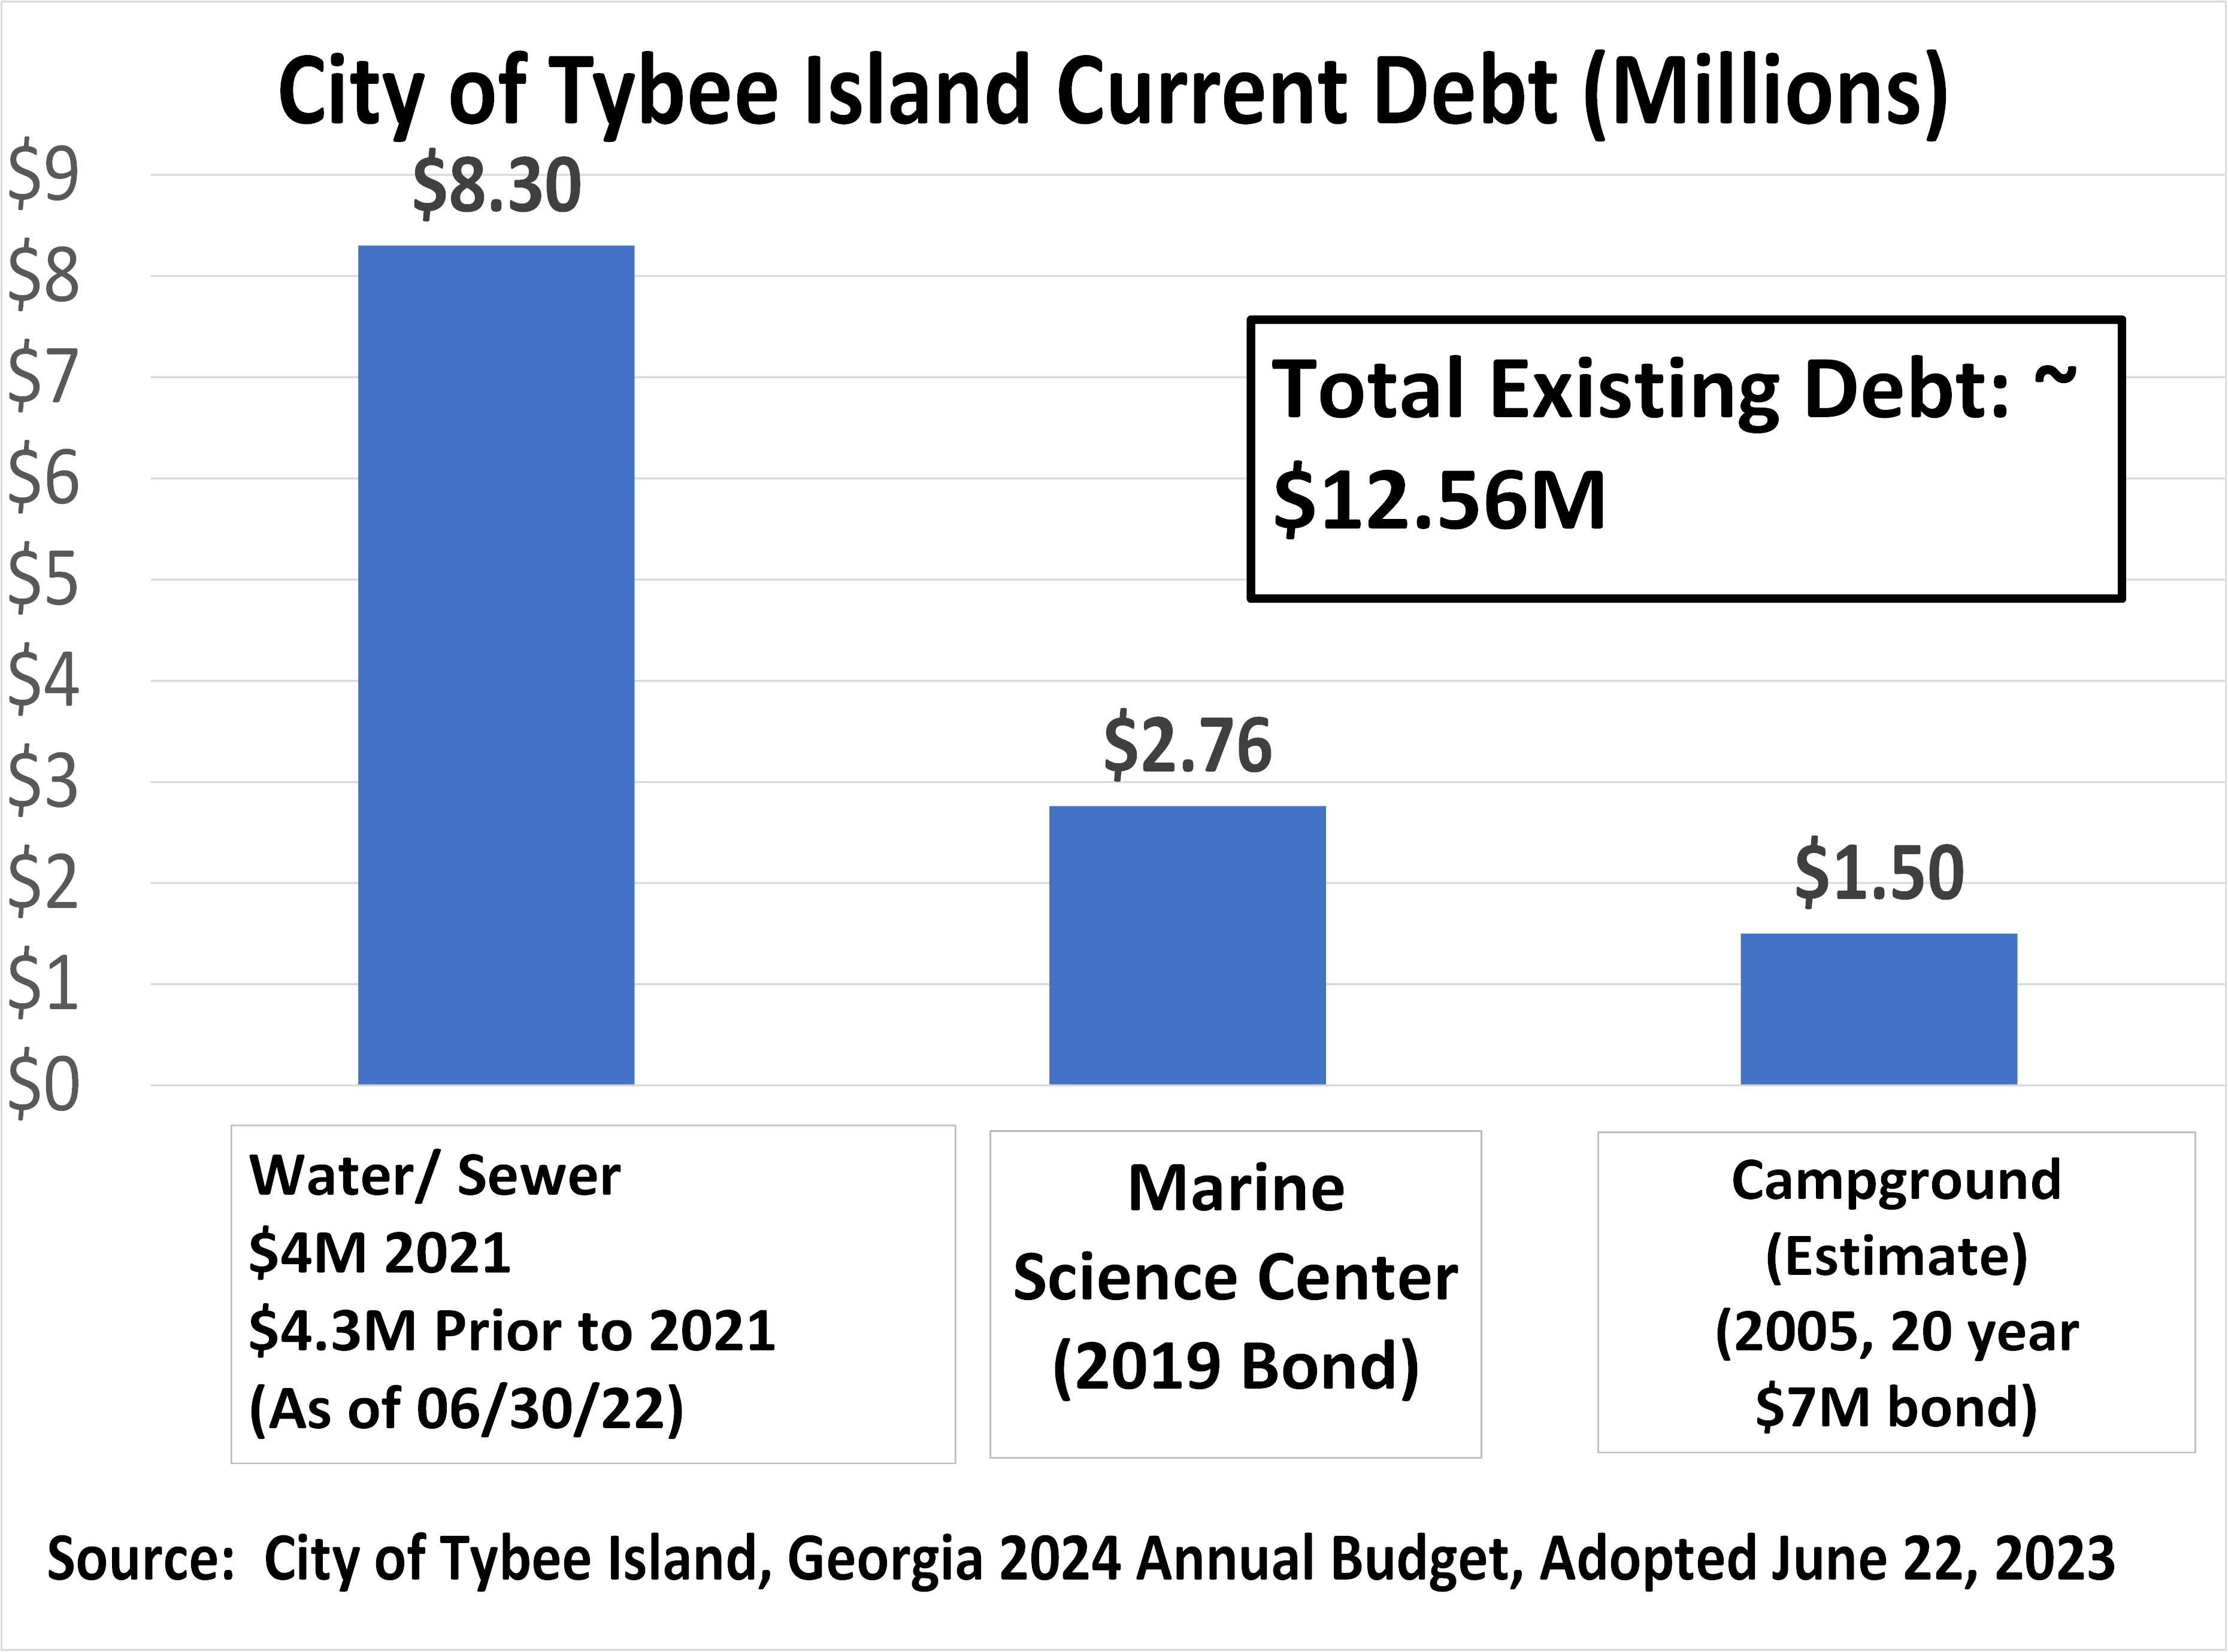
https://www.cityoftybee.org/DocumentCenter/View/4073/FY24-Final-Budget

Slide 2
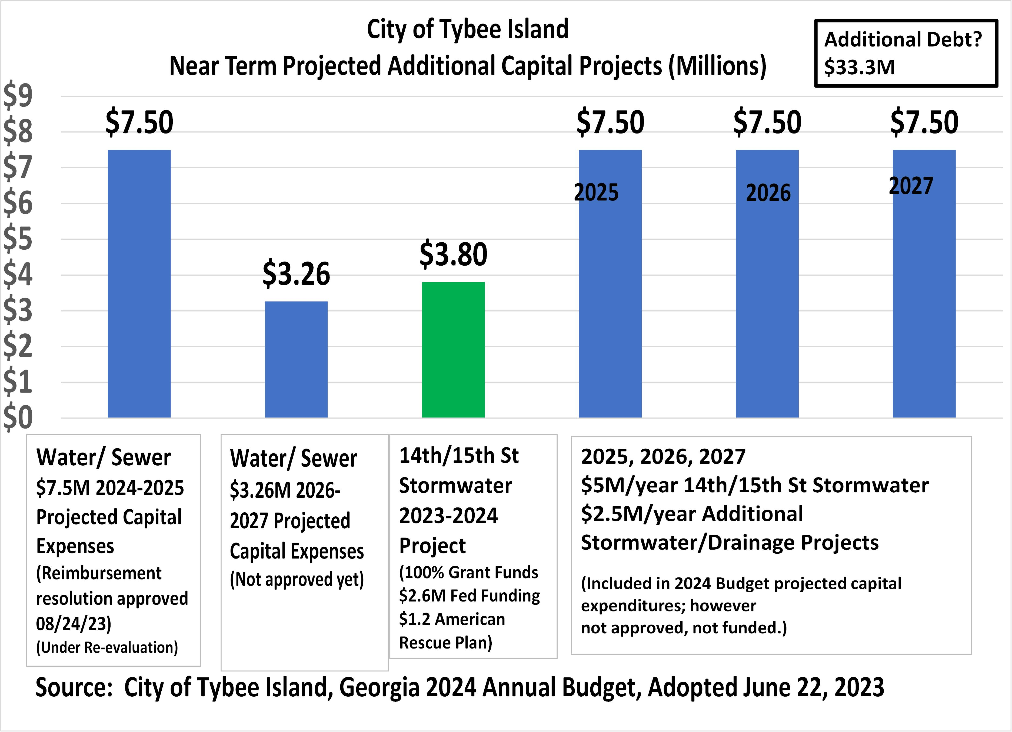
Grants/SPLOST/Bonds/Loans?
We need to prepare for these expenses.
https://www.cityoftybee.org/DocumentCenter/View/4073/FY24-Final-Budget

Slide 3
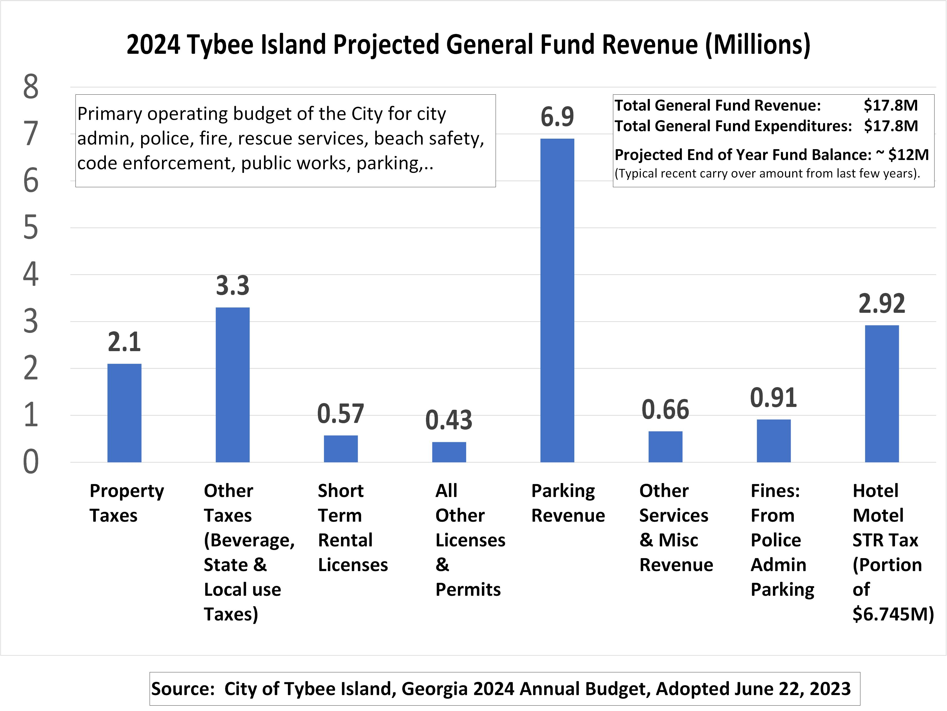
https://www.cityoftybee.org/DocumentCenter/View/4073/FY24-Final-Budget

Slide 4
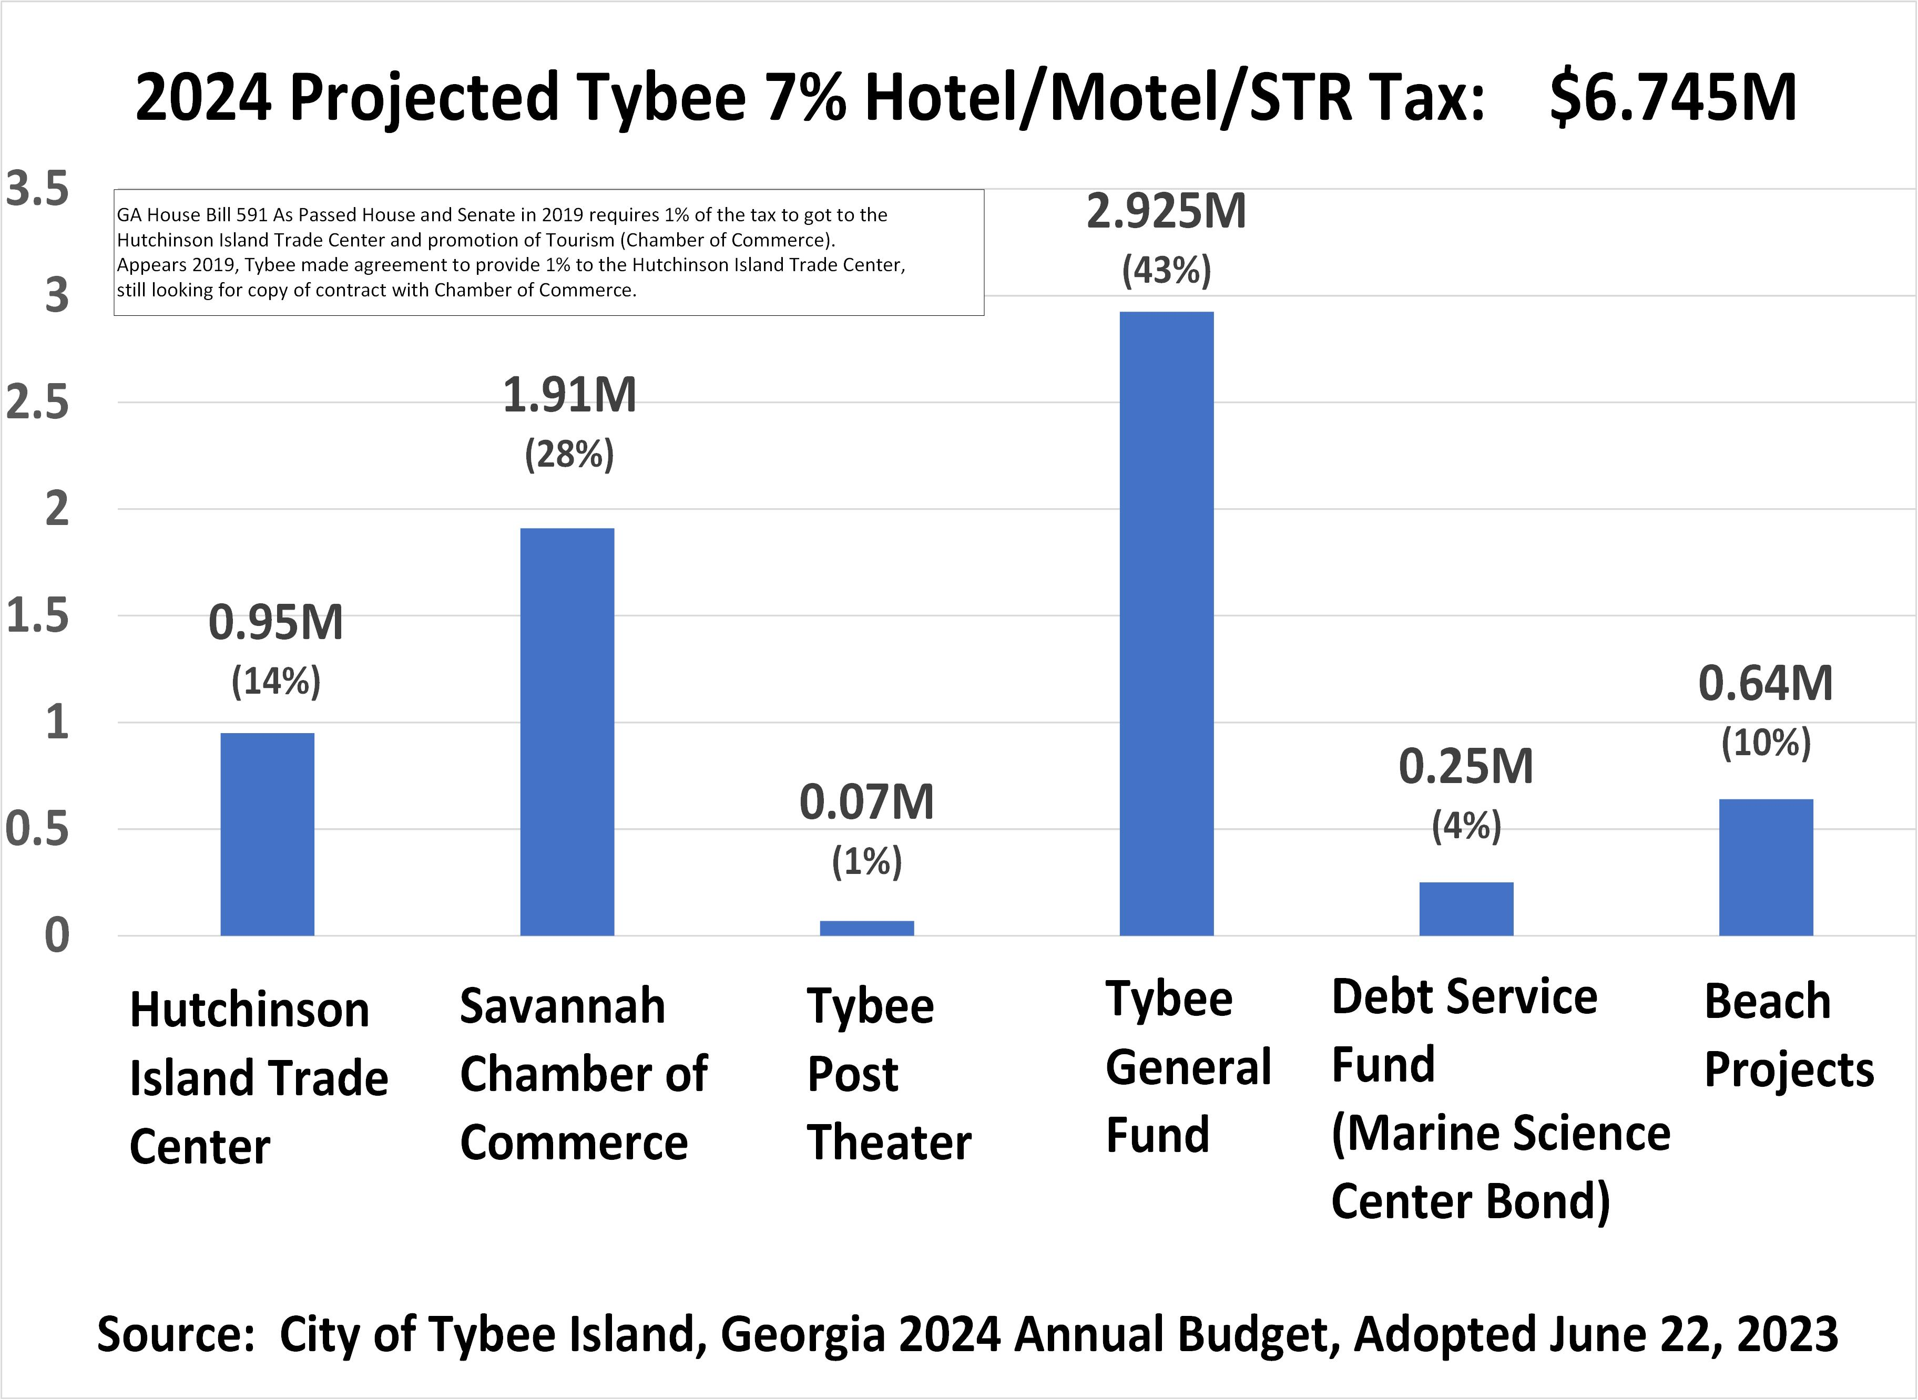
https://gov.georgia.gov/document/signed-legislation/hb-591pdf/download
https://www.cityoftybee.org/DocumentCenter/View/4073/FY24-Final-Budget

Slide 5
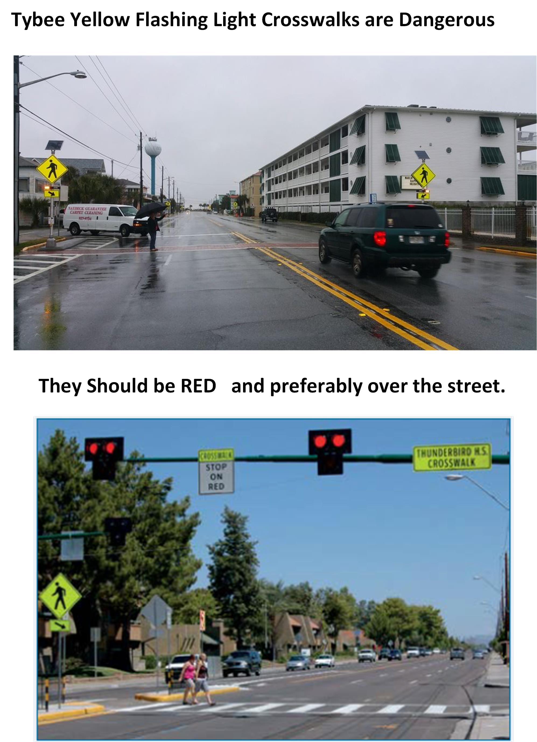

Slide 6
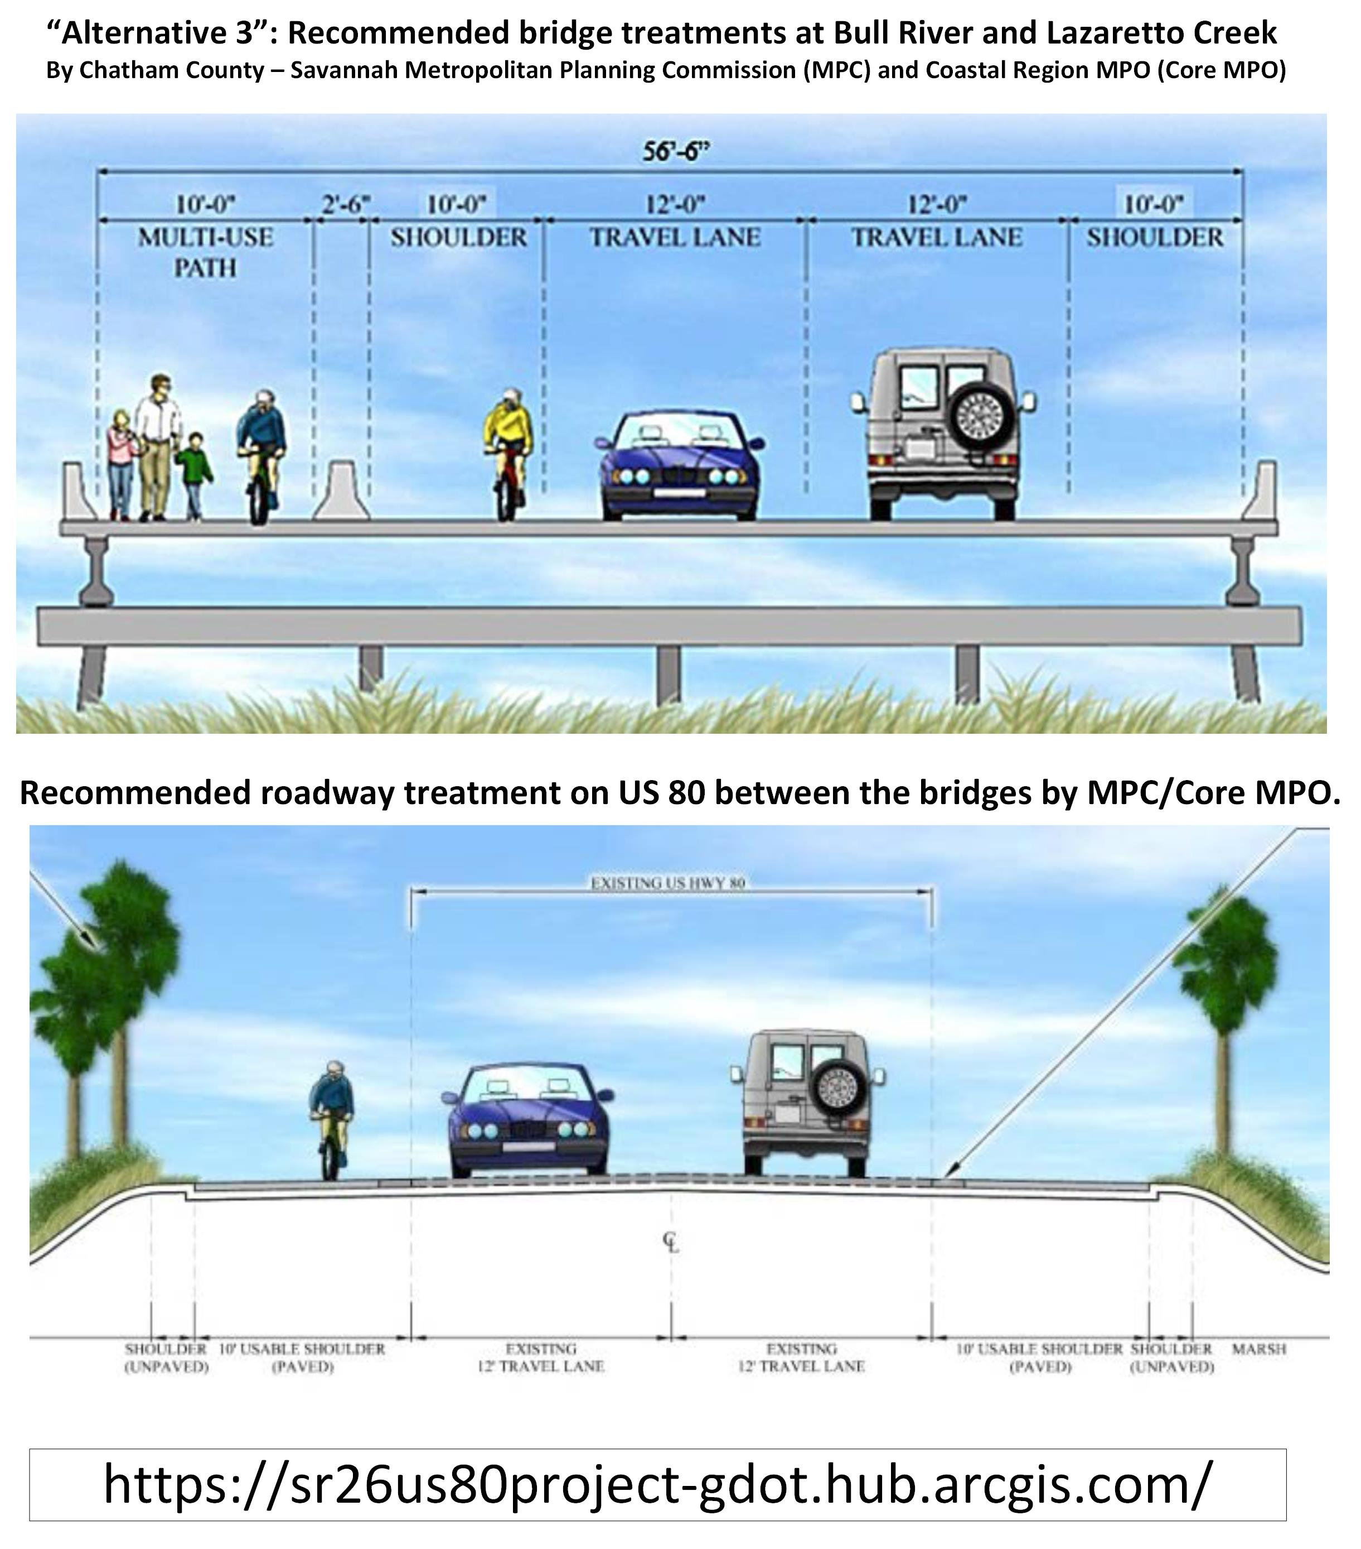
https://sr26us80project-gdot.hub.arcgis.com/

Slide 7
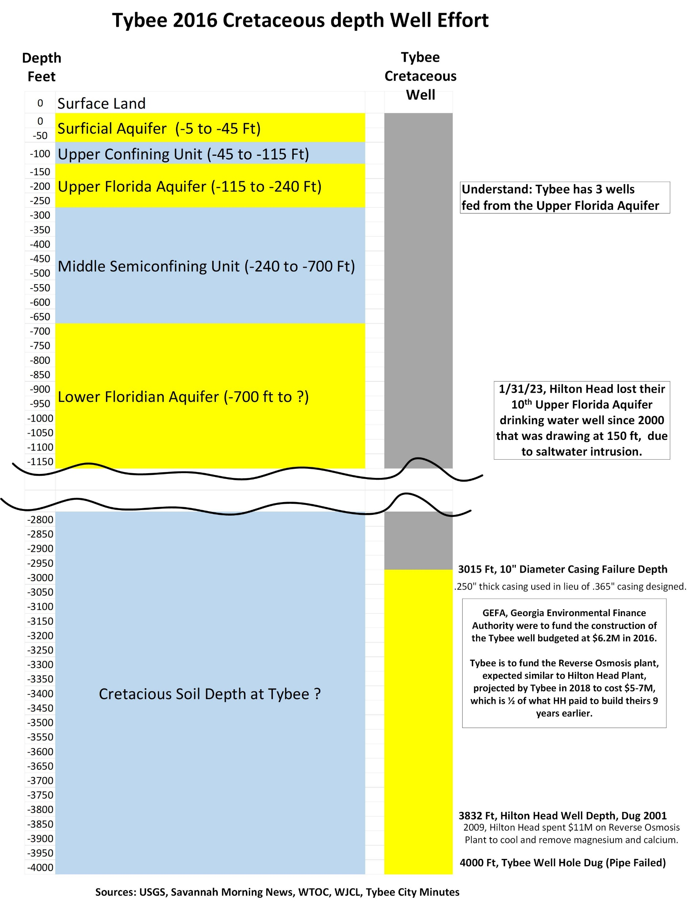
https://www.savannahnow.com/story/news/2018/08/14/georgia-sues-to-recover-costs-for-defunct-well-on-tybee/11046364007/
https://www.wjcl.com/article/future-of-tybee-island-well-project-in-jeopardy/8559315#
https://hhpsd.com/hilton-head-psd-loses-another-well-to-saltwater-intrusion-2
https://www.postandcourier.com/news/a-complex-threat-touches-southern-sc-coast-underground-saltwater/article_93d719d6-b1a6-11eb-8acd-e7bb17428ace.html

